Slide 1
Proposing a Multi-touch Interface for Intrusion Detection Environments
Jeffrey Guenther, Fred Volk, and Mark Shaneck

Slide 2
The Problem
Huge text-based network logs with more being created every second
Context is difficult to acquire from detail level tools
And only Jim knows what is really going on

Slide 3
Analysts need tools which:
Handle LARGE datasets
Provide context
Afford exploration
Manage cognitive load
Essentially, the Fundamental Problem of Visual Analytics

Slide 4
Current Visualizations
Consensus on the need for more interactivity
Access to both detail and contextual information
See Section 2.1 for a more detailed discussion

Slide 5
Getting to Know Analysts
Need more than a CTA
Activity Theory
provides a theoretical basis
need a multi-methods approach

Slide 6
Applying Activity Theory Example
Activities – keeping the network
Actions – reviewing logs
Operations – changing the configuration of a network sensor

Slide 7
A New Design Approach

Slide 8
A look at requirements:
Monitoring
Analysis
Response
Knowledge Management

Slide 9
Monitoring
Identify network state at a glance
Use pre-attentive visual properties to control the amount required attention

Slide 10
Analysis
Goal: to develop understanding
Multiple views at different levels of data abstraction

Slide 11
Response
Network management
Parts of response:
Record the happening of an event
Affect network changes

Slide 12
Knowledge Management
Capture Jim’s experience
Provides a library of case studies for future training
Must be a by product of using the tool, not an extra step

Slide 13
Our Design

Slide 14
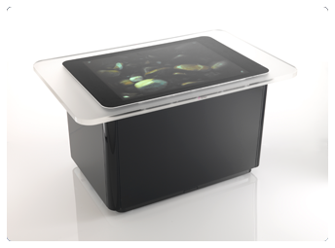
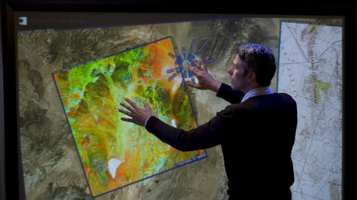


Multi-touch based network analytics tool

Slide 15
Affordances
Physical (embodied) interaction with interface
Gestures
Faster interaction than with a mouse

Slide 16
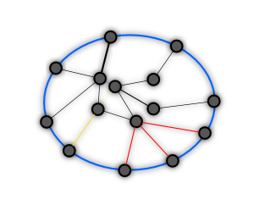
Zoomable, Spatial Exploration

Slide 17
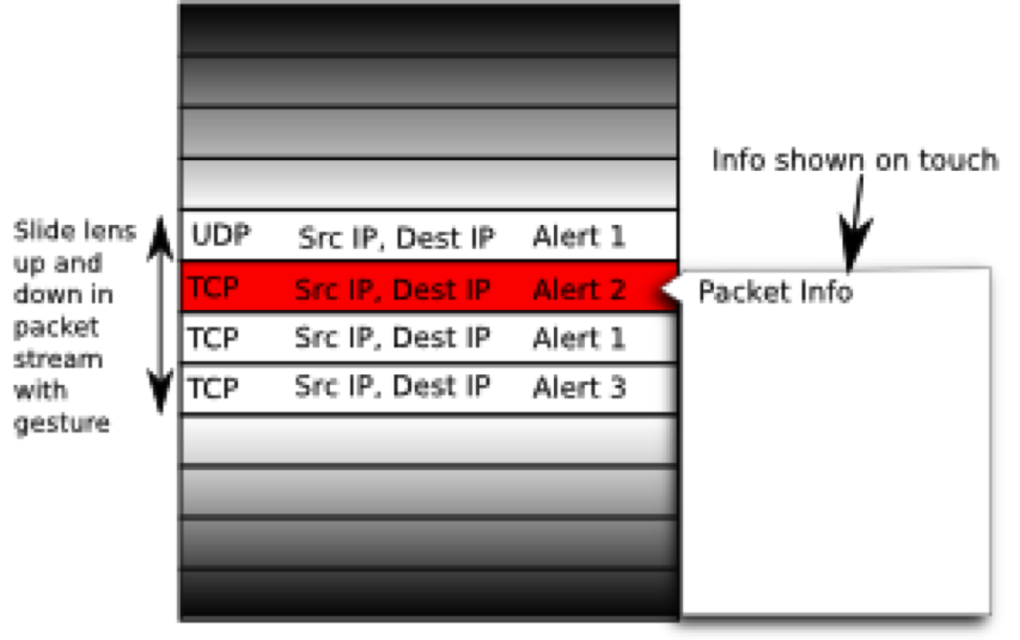
Packet Level

Slide 18
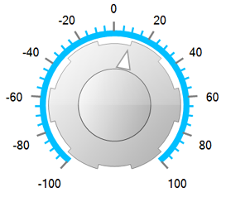
Time
devcomponents.com

Slide 19
Using Metadata
To learn context
To describe interactions -> create knowledge base

Slide 20
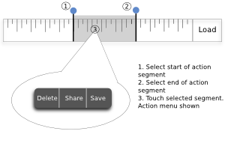
ActionLine

Slide 21
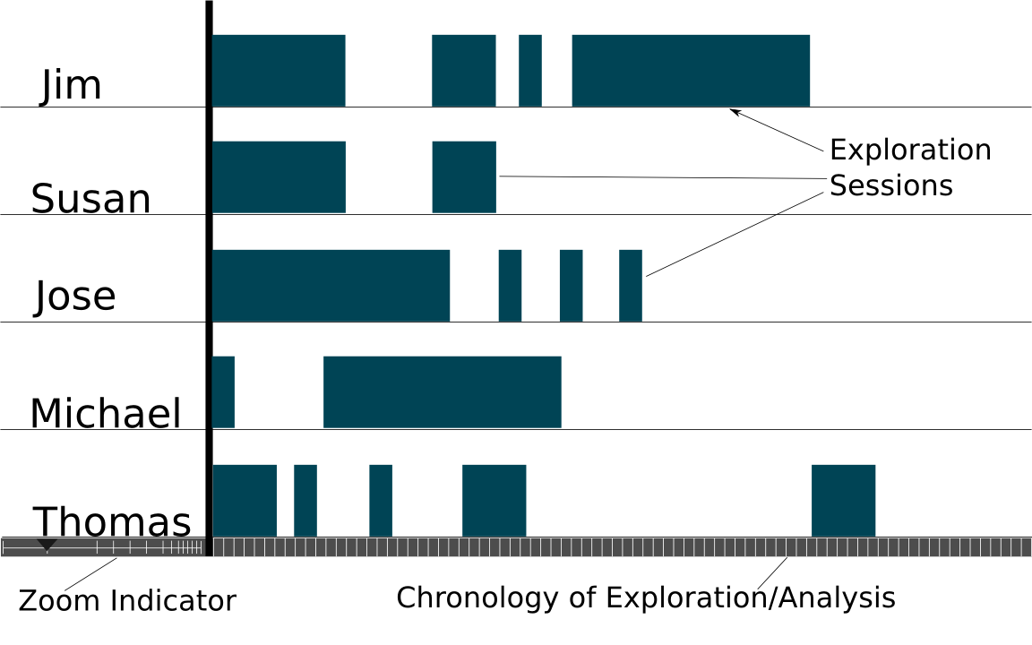
Knowledge Tracks

Slide 22
User-refined Alert Correlation
Make alert correlation interactive
Guided exploration of data
Allow addition/removal of events from attack
Correlation computation updated

Slide 23
Wrapping Up
Exposed the need for a multi-method research
List of Requirements:
Monitoring
Analysis
Response
Knowledge Management
Argued for a new mode of interaction

Slide 24
Questions?

